Slide 1
Mathematics in the store
Presentation was made by:
4th grade pupil
Kotryna Kundrotaitė

Slide 2
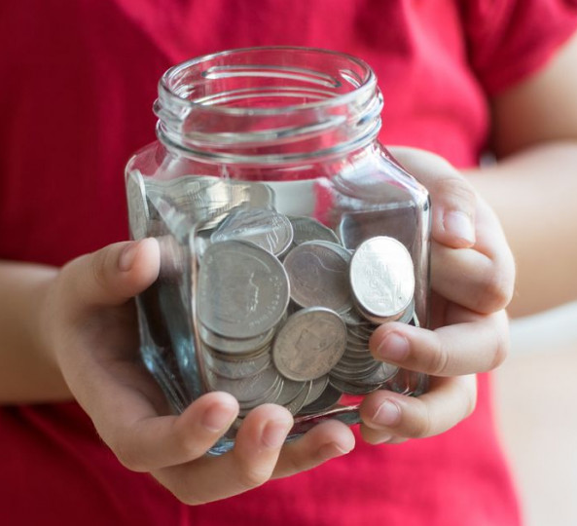
I wonder what I'll be able to buy at the store today for the money I have. I've calculated that I have 6 euros and 50 cents in total.

Slide 3
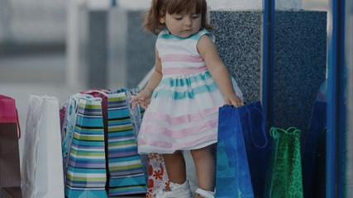
I wont be able to purchase this many things for sure. Even if I only want to buy new shoes, which cost 29 euros, I would still need 22 euros and 50 cents more.

Slide 4
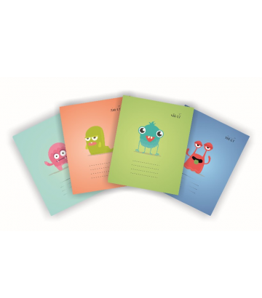
I also need 3 squared and 3 lined exercise books. One exercise book costs 15 cents, so 6 of them would cost 90 cents.

Slide 5
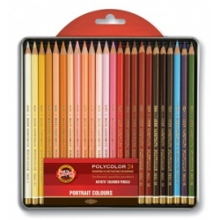
I shouldn't forget to buy some colored pencils aswell. After buying those notebooks I have 5 euros and 60 cents left. Pencils cost me 2 euros and 30 cents, so all I have left now is 3 euros and 30 cents.

Slide 6
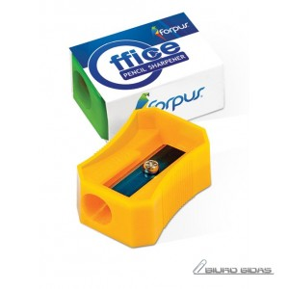
I would really like to buy a pencil sharpener and an eraser too, each of them cost 30 cents, so in total I will have to spend 60 cents. After these purchases I have 2 euros and 70 cents left.

Slide 7
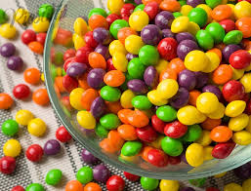
Of course I will buy some candy aswell. My favourite ones cost 90 cents.

Slide 8
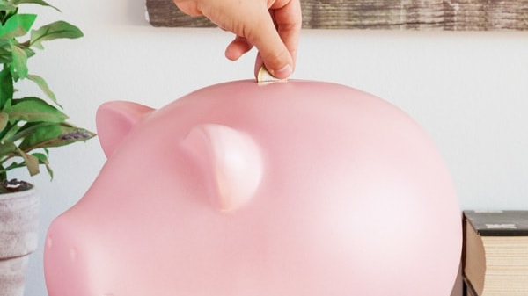
So, after the shopping all I have left is 1 euro and 80 cents. I will put them inside my piggy bank and spend next time when I'm going to the shop.

Slide 9
Thanks for your attention.

