Slide 1
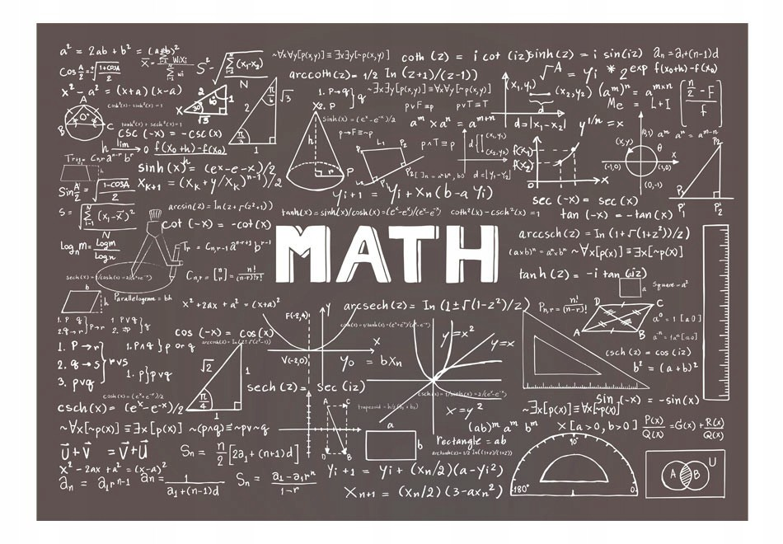
My day with math
Erika Stalgytė 4 b

Slide 2
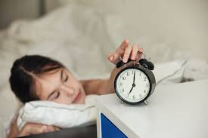
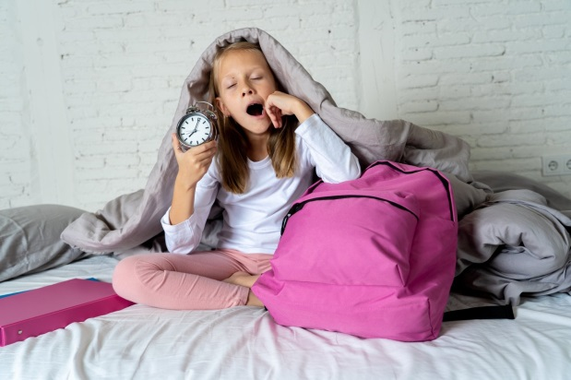
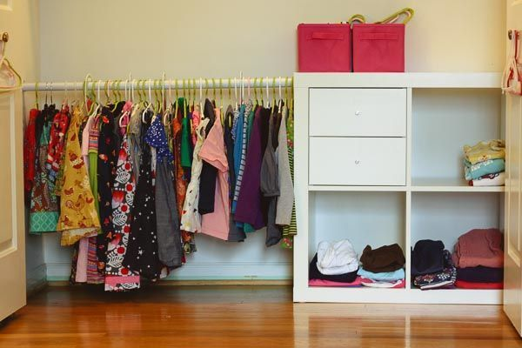
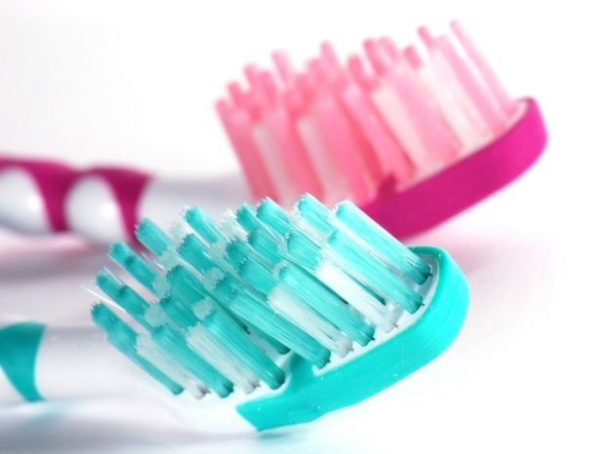
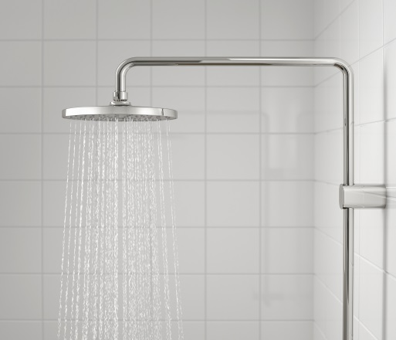
I get up at half past six.
I brush my teeth, have shower, get dressed at forty to six.
6:40-6:30= 10 min.

Slide 3
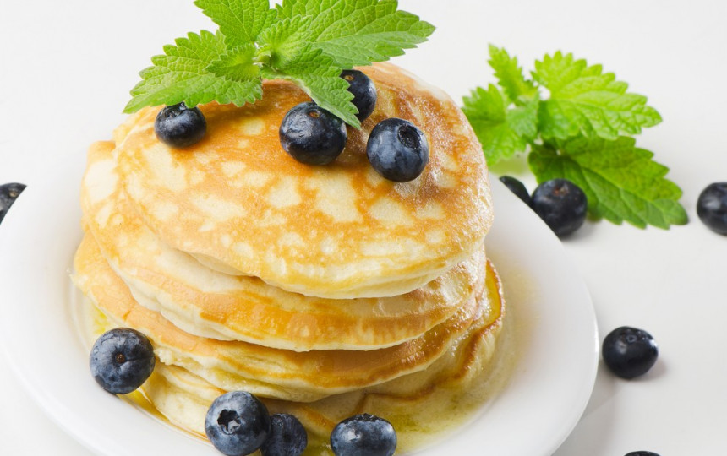
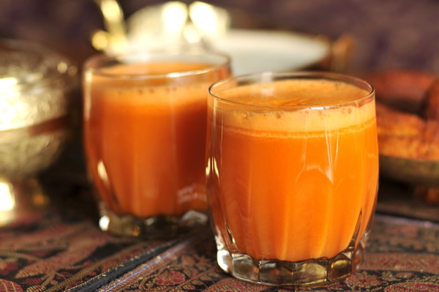
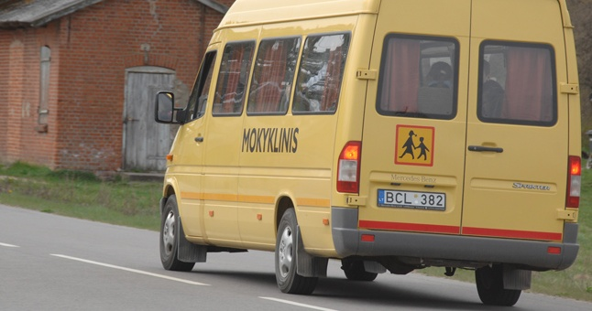
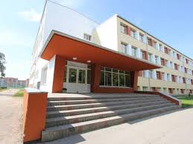
I have breakfast at twenty to seven. I go to school at ten to eight.
7:50-6:40= 1h 10 min.

Slide 4
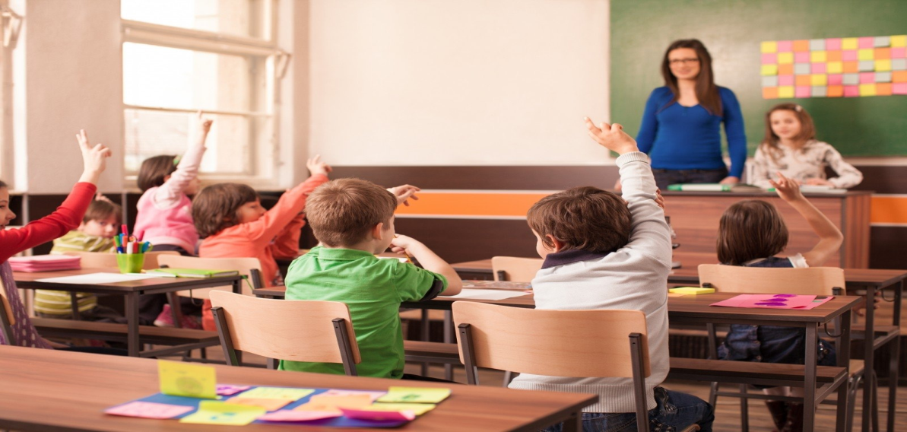
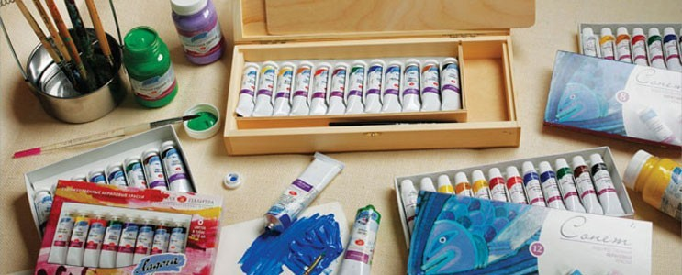
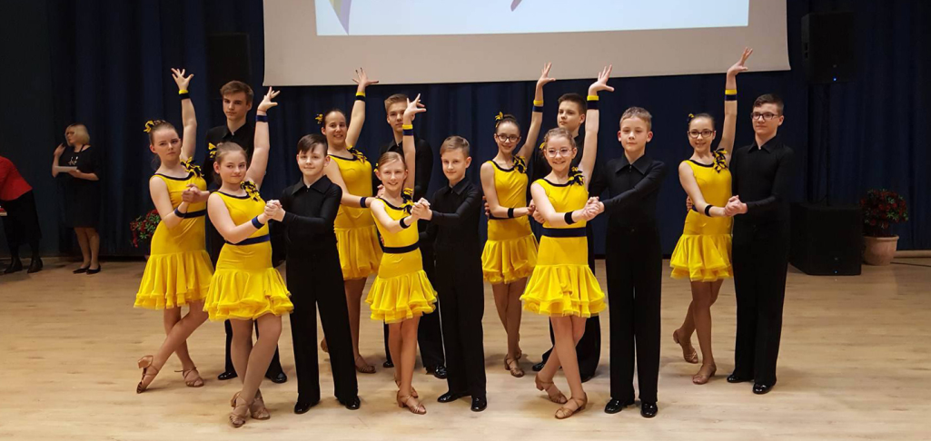
The lessons start at ten to eight.
I go to the Art lesson at two o’clock.
The Dance lesson starts at three o’clock.
16:15-7:50= 8h 05min.

Slide 5
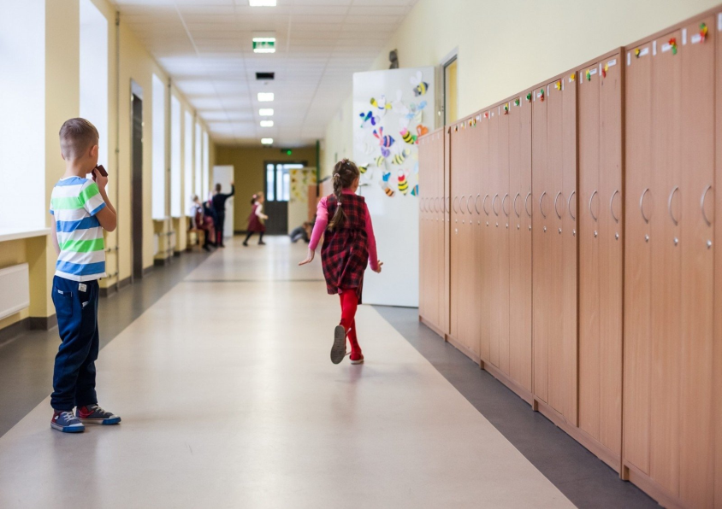
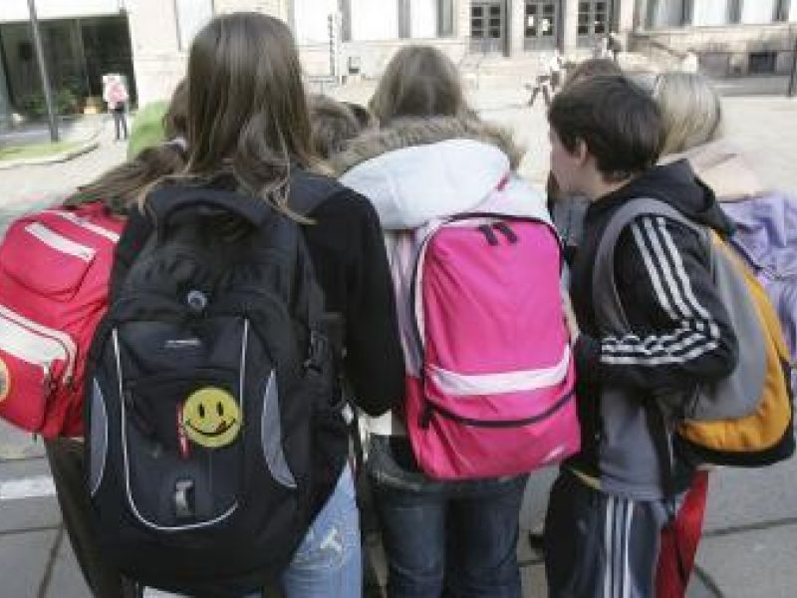
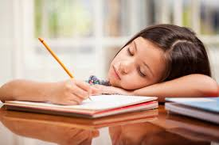
I go home a quarter past four.
I do my homework at half past five.
19:00-16:15= 2h 45min.

Slide 6
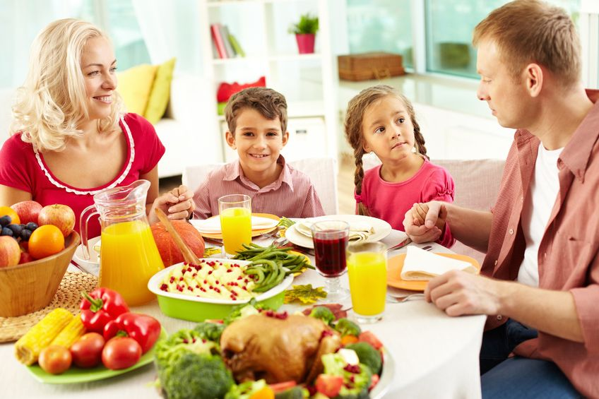
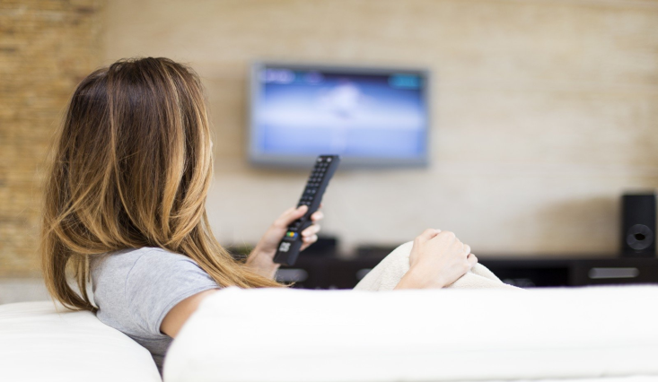
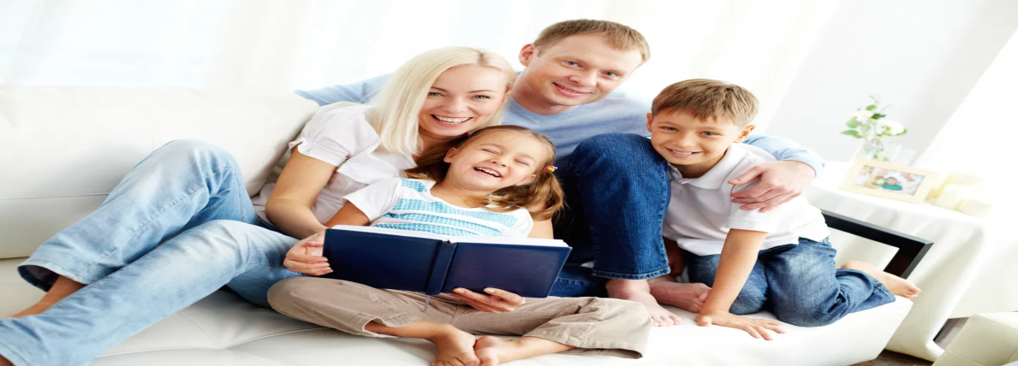
I have dinner at seven o’clock.
I watch TV at half past seven.
I talk with my family at nine o’clock.
21:30-19:00= 2h 30min.

Slide 7
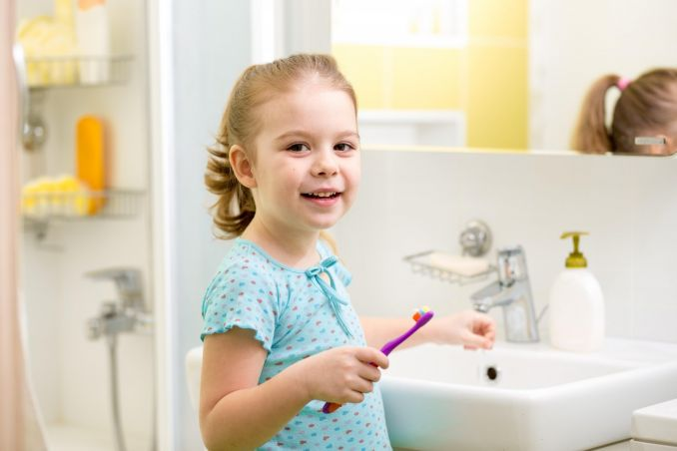
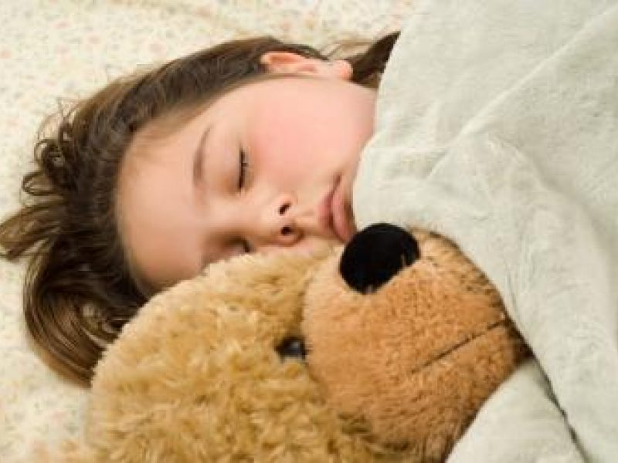
I brush my teeth at half past nine.
I go to bed at ten o’clock.
22:00-21:30= 30min.

Slide 8
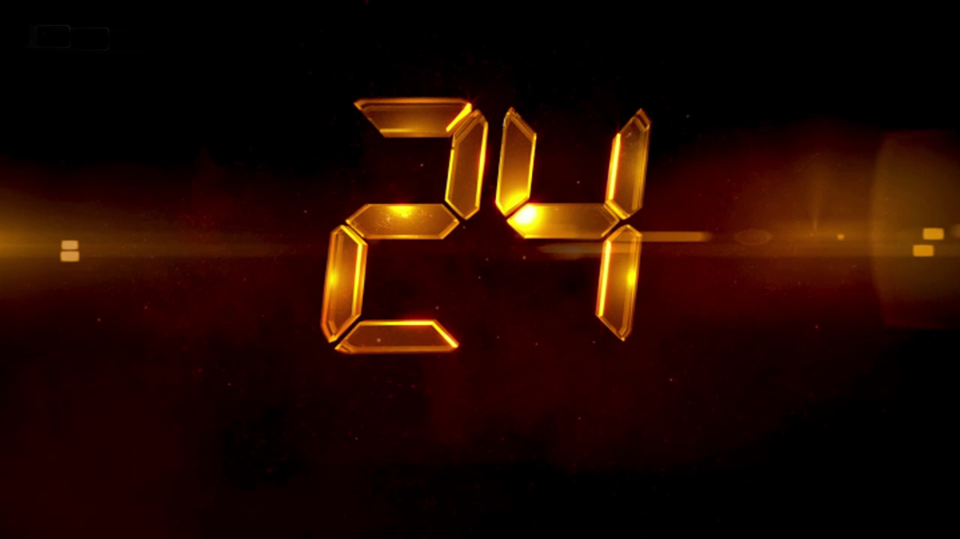
My day 24 hour :
My day lasts 15 hour 30 minutes ( 06:30-22:00)
10 min.+1h 10 min.+8h 05min.+2h 45min.+2h 30min.+ 30min.=15 h 30 min.
I sleep 8 hour 30 minutes (22:00-06:30)
15:30 h+8:30 h = 24 h

Slide 9
Thanks for the attention

